Slide 1
A Transformation Agenda: a closer look at learning, teaching and supporting educators
Master’s in Educational Leadership Research Conference
March 2, 2013

Slide 2
Quality Teaching and Learning Initiative
SD 6 (Rocky Mountain)
Heather Brown – teacher
SD 43 (Coquitlam)
Nancy Bennett – principal
SD 45 (West Vancouver)
Liz Hill – principal
SD 60 (Peace River North)
Stephen Petrucci –
Director of Instruction
SD 61 (Victoria)
Gord Mitchell – vice principal
SD 64 (Gulf Islands)
Shannon Shields –
vice principal
Ministry of Education
Cathy Elliott –
Quality Teaching & Learning Initiative

Slide 3
QTL Pieces
Multiple projects within districts
Ministry of Education
QTL - 6 Districts + MOE
Framework QTL group
District Teams

Slide 4
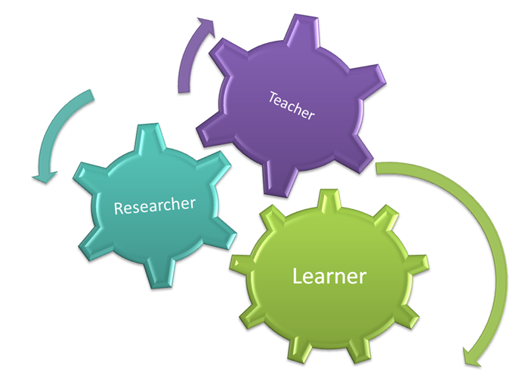
Teacher as learner/researcher/practitioner
International research
BC Education transformation
QTL Initiative

Slide 5
Guiding Questions
What does quality learning look like?
What does quality teaching look like?
How are we supporting teaching/learning practices?
What is emerging?
What is enduring?

Slide 6
QTL Conceptual Framework
Learning
Learning
Teaching
Supporting teaching/learning practices
Teaching
Supporting teaching
and learning practices

Slide 7
Our beginning…
Stories of innovation from each district
Common threads became OUR research base
Circular model of research/researcher, teacher/learner would guide us

Slide 8
Who are we learning from?
Michael Fullan and Andy Hargreaves on leadership and the change process
Rick Dufour on Professional Learning Communities
Bruce Wellman, Doug Reeves on leadership work
Judy Halbert, Linda Kaser on the inquiry process and leadership mindsets
Wiliam and Black on assessment
John Hattie’s meta-analyses of research relating to student achievement

Slide 9
Making connections….
Between research and conversations going on around our province of BC and within the Ministry of Education.

Slide 10
Who are we learning from internationally about small or large scale systems of innovation?
GELP 3.0
Innovation Unit
OECD
Stupski Foundation
Centre for Strategic Education

Slide 11
What have we learned from the research?
21st Century pressures provide the impetus for change
It is important to address broader and deeper concerns regarding the quality of life, social justice and sustainability
To identify learning skills for a world where technology accelerates every reform
Matching the correct innovation to each stage of the journey

Slide 12
What have we learned from the research?
Critical role of motivation and engagement
Making learning visible
Learning in families and communities
Circular nature of our work as teachers and learners, learners and teachers, researchers and researching

Slide 13
Guiding Questions
What does quality learning look like?
What does quality teaching look like?
How are we supporting teaching/learning practices?
What is emerging?
What is enduring?

Slide 14
Learning
Collaborative
Connected
Learner ownership
(choice & flexibility)
Engaging, authentic
and real
Broad and
interdisciplinary
Open-ended
Personalized
Teaching
A changing role of teacher from holder of knowledge to learner
Shift from content to competency
Personalized
Support
Supportive social environments
Collective capacity building utilizing the concept of PLC’s
Importance of being responsive
Personalized

Slide 15
What is quality learning looking like?
Engaging and motivating
Collaborative
Connected
Learner ownership (choice & flexibility)
Authentic, purposeful and real
Broad and interdisciplinary
Open-ended
Personalized

Slide 16
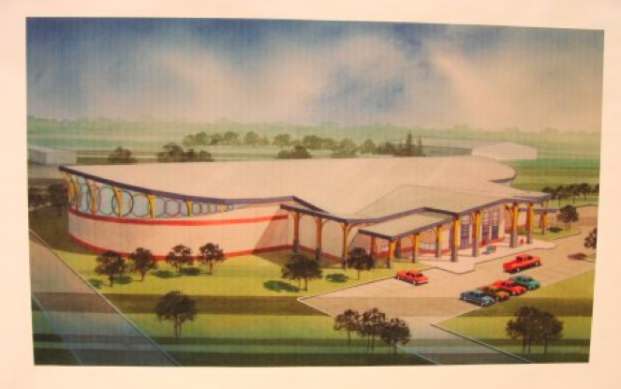
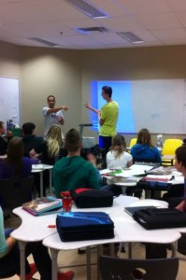
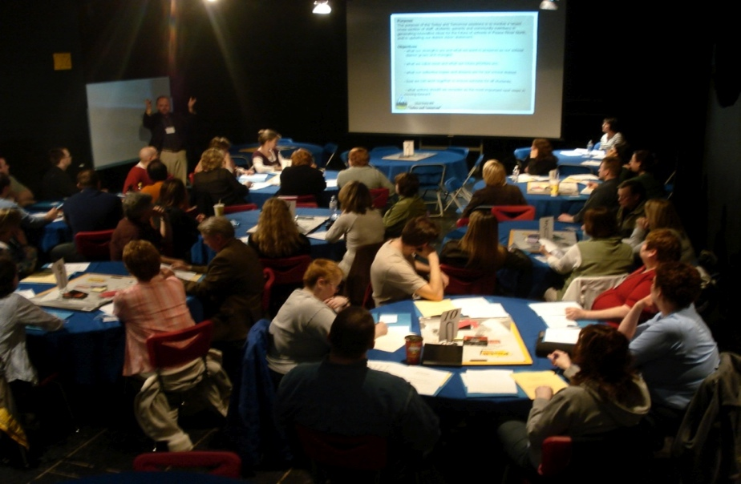

Slide 17
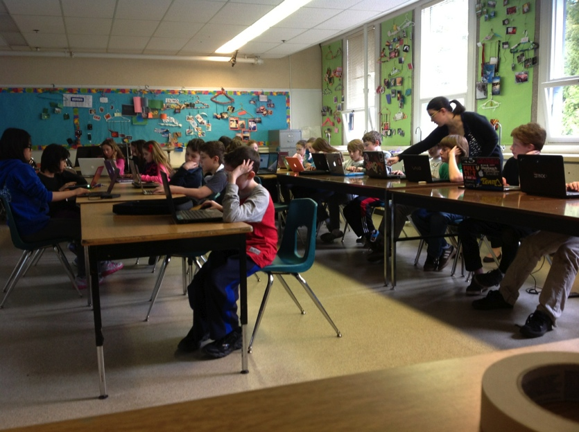
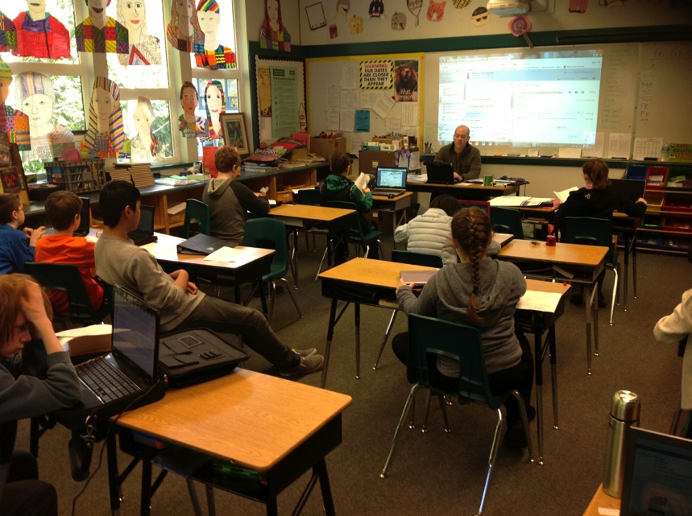

Slide 18
What is quality teaching looking like?
Engaging and motivating
Collaborative
Connected
Learner ownership (choice & flexibility)
Authentic, purposeful and real
Broad and interdisciplinary
Open-ended
Personalized

Slide 19
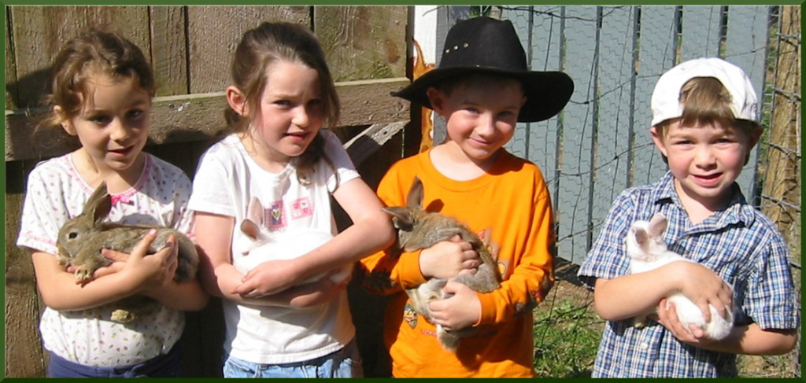
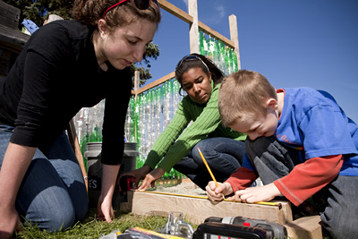
Peace River North Farm Project

Slide 20
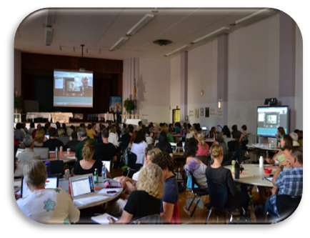
Inquiry Model from Victoria

Slide 21
How are we supporting teaching and learning practices?
Engaging and motivating
Collaborative
Connected
Learner ownership (choice & flexibility)
Authentic, purposeful and real
Broad and interdisciplinary
Open-ended
Personalized

Slide 22
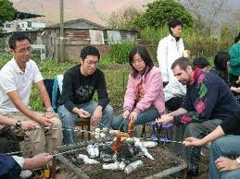
Supportive Social Environments

Slide 23
Gulf Islands Coaching and Coquitlam Mentoring Programs

Slide 24
Learning, Teaching and Supporting
Engaging and motivating
Collaborative
Connected
Learner ownership (choice & flexibility)
Authentic, purposeful and real
Broad and interdisciplinary
Open-ended
Personalized

Slide 25
QTL Conceptual Framework
Learning
Learning
Teaching
Supporting teaching/learning practices
Teaching
Supporting teaching
and learning practices

Slide 26
Dynamic Nature of Emerging and Enduring Practices
Enduring
Assessment (for, as, of)
Relationships
The basics
Differentiated Instruction
Emerging
New basics
Coaching/collaboration
UDL-student centric
Voice/choice
Inquiry based
Technology accelerates

Slide 27
Guiding Questions
What does quality learning look like?
What does quality teaching look like?
How are we supporting teaching/learning practices?
What is emerging?
What is enduring?

Slide 28
Connecting and Inspiring
This process didn’t happen to us
We do not have all the answers
This is a process of the teacher/learner/researcher
Build on what is already happening
Not scaling up
By affiliation, our learning grows

Slide 29
Quality Teaching and Learning Initiative Team
SD 6 (Rocky Mountain)
Heather Brown heather.brown@sd6.bc.ca
(Cheryl Lenardon, Stacy Decosse, Angela Stott)
SD 43 (Coquitlam)
Nancy Bennett nlbennett@sd43.bc.ca
(Sylvia Russell, Nancy Carl, Elspeth Anjos) @nlbennett2
SD 45 (West Vancouver)
Liz Hill lhill@sd45.bc.ca
(Gary Kern, Lynne Tomlinson, Jeanette Laursoo) @lizhill45
SD 60 (Peace River North)
Stephen Petrucci spetrucci@prn.bc.ca
(Larry Espe, Dave Sloan, Jarrod Bell) @s1pertucci
SD 61 (Victoria)
Gord Mitchell gmitchell@sd61.bc.ca
(Deb Courville, Ingrid Fawcett, Nadine Naughton) @gmitchell_sd61
SD 64 (Gulf Islands)
Shannon Shields sshields@sd64.bc.ca
(Jeff Hopkins, Kelda Logan, Lyall Ruehlen) @shannoneshields
Ministry of Education
Cathy Elliott cathy.elliott@gov.bc.ca
(Rick Davis, Rueben Bronee, Debbie Kennedy)

Slide 30
Who are we learning from?
Books:
DuFour, Rick
Leaders of Learning: How District, School and Classroom Leaders Improve Student Achievement, 2011; and many other books
Fullan, Michael
Stratosphere: Integrating Technology, Pedagogy, and Change Knowledge, 2012
Change Leader: Learning to Do what Matters Most, 2011
All Systems Go: The Change Imperative for Whole System Reform, 2010; and many other books
Fullan and Hargreaves
Professional Capital: Transforming Teaching in every School, 2012
Hargreaves, Andy
The Fourth Way: The Inspiring Future for Educational Change, 2009
Sustainable Leadership, 2005

Slide 31
Who are we learning from?
Books:
Hattie, John
Visible Learning, 2008
Visible Learning for Teachers: Maximizing Impact on Learning, 2011
Kaser, Linda and Halbert, Judy
Leadership Mindsets: Innovation and Learning in the Transformation of Schools, 2009
Marzano , Robert
Teaching and Assessing 21st Century Skills, 2011; The Highly Engaged Classroom, 2010
Sahlberg, Pasi
Finnish Lessons, 2010
Wiliam, Dylan and Black, Paul
Inside the Black Box: Raising Standards through Classroom Assessment, 2005
Zhao, Yong
World Class Learners: Educating Creative and Entrepreneurial students, 2012

Slide 32
Who are we learning from?
Articles/Publications
Empowering Effective Teachers - Readiness for Reform,
Bill and Melinda Gates Foundation
Closing the Talent Gap , McKinsey and Company
Building a High Quality Teaching Profession, OECD
The Learning Society, Cisco
Learning from the Extremes, Cisco

Slide 33
Who are we learning from?
Articles/Publications
Choosing the Wrong Drivers for Whole System Reform, Michael Fullan
Equipping Every Learner for the 21st Century, Cisco
Innovating to Learn, Learning to Innovate, OECD
10 Ideas for 21st Century Education, Innovation Unit
Developing an Innovation Ecosystem for Education, Valerie Hannon/Alec Patton/Julie Temperley – Innovation Unit

